Slide 1
THE SECRET TO TRANSFORM YOUR LIFE FORMULA

Slide 2

WORTH 1999/-
FOR ‘ACTION TAKER’ ONLY 499/-

Slide 3

WHAT WILL YOU LEARN?
WHAT IS MIND ?
TYPES OF MIND
POWERS OF SUBCONSCIOUS MIND
HOW TO USE MIND POWER TO BECOME SUCCESSFUL.
WHAT IS MINDSET ?
HOW TO CHANGE OUR MINDSET ?
WHAT IS GOAL ?
HOW TO ACHIEVE OUR GOAL ?

Slide 4
THE SECRET TO TRANSFORM YOUR LIFE BLUEPRINT

Slide 5


WORTH 10000/ WORTH 5000/-
5000/- + FREEE !!!!!

Slide 6

YOU WILL LEARN ?
WHAT IS MIND ?
TYPES OF MIND
LEVEL OF MIND
STATE OF MIND
POWERS OF SUBCONSCIOUS MIND
HOW TO USE MIND POWER TO BECOME SUCCESSFUL.
WHAT IS GRATITUDE ?
POWER OF GRATITUDE.
WHAT IS MINDSET ?
WHAT IS POSITIVE MINDSET ?
WHAT IS NEGATIVE MINDSET ?
HOW TO CHANGE OUR MINDSET ?
WHAT IS GOAL ?
HOW TO ACHIEVE OUR GOAL ?

Slide 7
TODAY’S SPECIAL OFFER FOR ‘ACTION TAKER’
ONLY 1,999/-

Slide 8
REPROGRAM YOUR MIND CHALLENGE

Slide 9

21 DAYS LIVE WORKSHOP
WORTH 25000/ IS NOW 15000/-

Slide 10
YOU WILL LEARN
WHAT IS MIND ?
TYPES OF MIND
LEVEL OF MIND
STATE OF MIND
POWERS OF SUBCONSCIOUS MIND
HOW TO USE MIND POWER TO BECOME SUCCESSFUL.
WHAT IS MINDSET ?

Slide 11
WHAT IS POSITIVE MINDSET ?
WHAT IS NEGATIVE MINDSET ?
WHAT IS CONSTANT MINDSET ?
WHAT IS GROWTH MINDSET ?
WHAT IS RICH MINDSET ?
HOW TO CHANGE OUR MINDSET ?
WHAT IS GRATITUDE ?
HOW TO STOP PROCASTINATION ?

Slide 12
WHAT IS GOAL ?
HOW TO ACHIEVE OUR GOAL ?
WHAT IS VISUALISATION ?
POWER OF VISUALISATION
WHAT IS AFFIRMATION ?
POWER OF AFFIRMATION
WHAT IS VIBRATION ?

Slide 13
POWER OF VIBRATION
WHAT IS LAW OF ATTRACTION ?
HOW LAW OF ATTRACTION WORKS ?
WHAT IS MEDITATION ?
BENEFITS OF MEDITATION.
HOW TO DO MEDITATION ?
HOW TO BUILD GOOD HABBITS ?
21 DAYS MIRACLE MORNING SESSION LIVE AT 5 AM TO GAIN ULTIMATE ENERGY.

Slide 14


WORTH 10000/-
FREEE !!!

Slide 15



Slide 16

SPECIAL OFFER FOR TODAY WORTH 10000/ IS NOW FREE !!

Slide 17
TODAY’S SPECIAL OFFER FOR ‘ACTION TAKER’
ONLY 4999/-

Slide 18
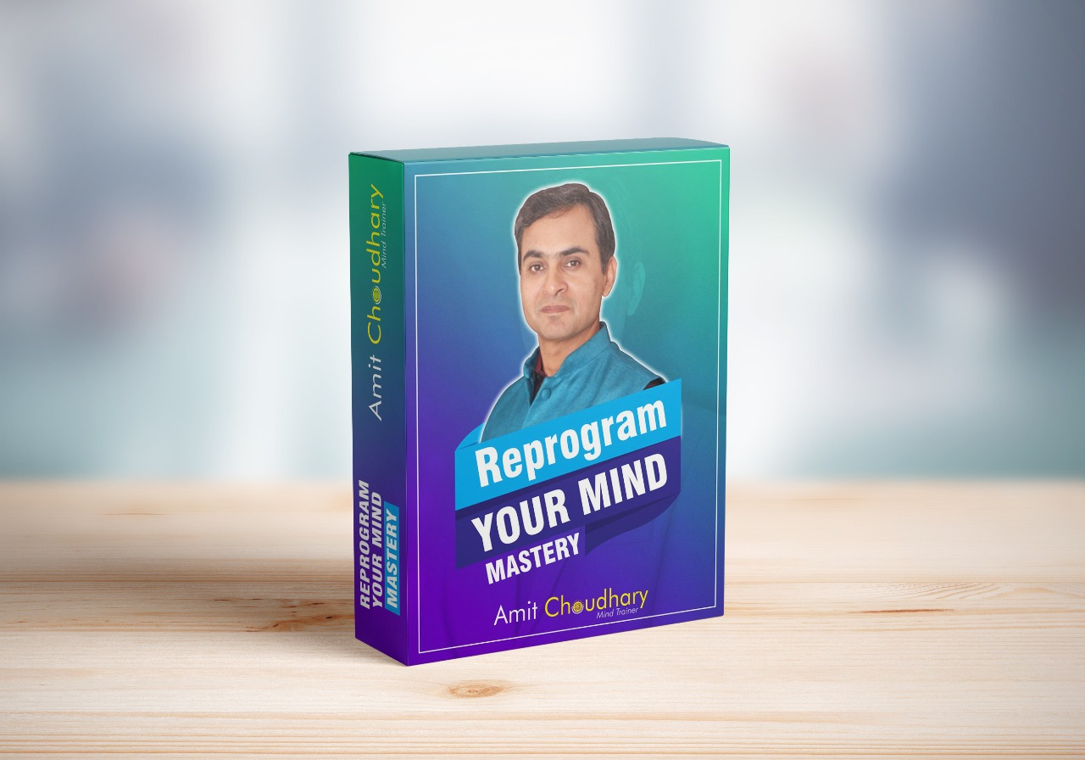
90 DAYS LIVE WORKSHOP W0RTH 75000/- IS NOW 25000/-

Slide 19
YOU WILL LEARN
WHAT IS MIND ?
TYPES OF MIND
LEVEL OF MIND
STATE OF MIND
POWER OF CONSCIOUS MIND
POWER OF SUBCONSCIOUS MIND
WHAT IS MIND POWER ?
HOW TO USE MIND POWER TO BECOME SUCCESSFUL ?

Slide 20
WHAT IS MINDSET ?
WHAT IS POSITIVE MINDSET ?
WHAT IS NEGATIVE MINDSET ?
WHAT IS CONSTANT MINDSET ?
WHAT IS GROWTH MINDSET ?
WHAT IS RICH MINDSET ?
HOW TO CHANGE OUR MINDSET ?
WHAT IS GRATITUDE ?
HOW TO STOP PROCASTINATION ?

Slide 21
WHAT IS GOAL ?
HOW TO ACHIEVE OUR GOAL ?
FOUR PILLARS OF LIFE.
WHAT IS VISUALISATION ?
POWER OF VISUALISATION
POWER OF AFFIRMATION
WHAT IS ENERGY ?
POWER OF PRAYER

Slide 22
POWER OF VIBRATION
WHAT IS LAW OF ATTRACTION ?
HOW LAW OF ATTRCTION WORKS ?
WHAT IS MEDITATION ?
BENEFITS OF MEDITATION.
HOW TO DO MEDITATION ?
HOW TO BUILD GOOD HABBITS ?
90 DAYS MIRACLE MORNING SESSION LIVE AT 5 AM TO GAIN ULTIMATE ENERGY.
WEEKLY LIVE SESSIONS (90 DAYS)

Slide 23
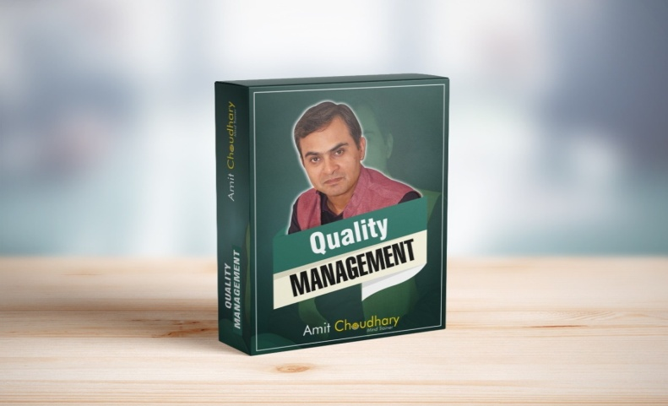


WORTH RS 20000/- (5000 EACH)
FREEEEE !!!!

Slide 24
YOU WILL LEARN
WHAT IS QUALITY ?
QUALITY OF PRODUCT
QUALITY OF SERVICE
LEAN MANAGEMENT
GLIMPSE OF SIX SIGMA

Slide 25

YOU WILL LEARN
WHAT IS RELATION ?
IMPORTANCE OF RELATIONSHIP.
HOW TO MAINTAIN A RELATION ?
IMPORTANCE OF COMMUNICATION IN A RELATION.

Slide 26
YOU WILL LEARN
24 HOUR TIME MANAGEMENT
TIME ANALYSIS
HOW TO STOP PROCASTINATION ?
IMPORTANCE OF
TO-DO LIST

Slide 27
YOU WILL LEARN
MONEY MANAGEMENT
FINANCIAL FREEDOM TECHNIQUE
MONEY EMOTION
SECRET OF MONEY MINDSET

Slide 28


Slide 29

WORTH RS 15000/- IS NOW
FREE !!!

Slide 30
TODAY’S SPECIAL OFFER FOR
‘ACTION TAKER’
ONLY 14999/-

